Slide 1
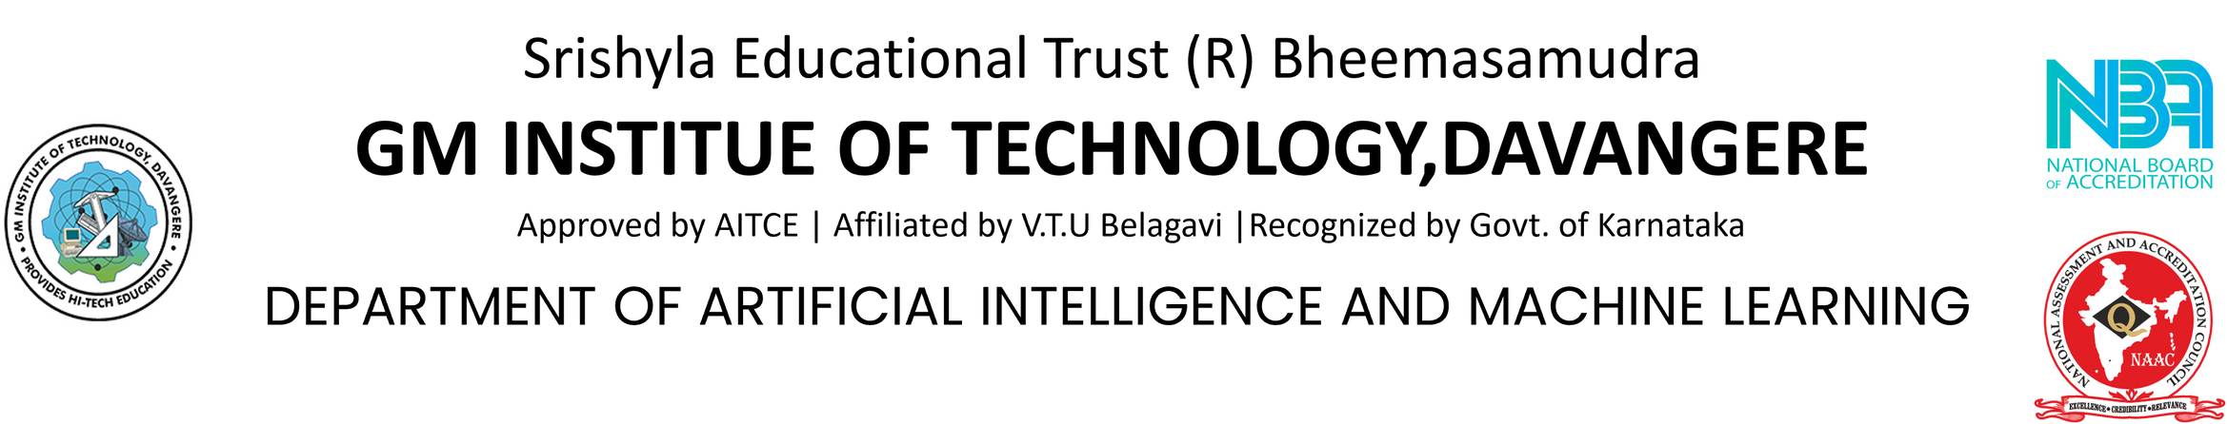
PROJECT PRESENTATION ON
SIGN LANGUAGE INTERPRETER
UNDER THE GUIDANCE OF:
MRS. AKSHATHA A M S
ASST. PROFESSOR
DEPT OF AI & ML
GMIT, DVG
PRESENTED BY:
ABHISHEK T M 4GM20AI002
SOURAV H S 4GM20AI054
SUHAS B M 4GM20AI055
V SRI KRISHNA DEVA RAYUDU 4GM20AI059

Slide 2
CONTENTS
Introduction
Problem Statement
Objectives
Literature Survey
Design Methodology
Proposed System
System Implementation
Technologies Used
Results
Conclusion
References

Slide 3

INTRODUCTION
1
The project aims to create a cost-effective "Sign-Language Interpreter" to assist communication for India's hearing-impaired population, meeting a crucial societal need.
Sign Language Recognition (SLR) is crucial in bridging communication gaps for individuals with hearing impairments by recognizing sign language actions in the digital world.
This project is limited by inadequate training data for regional sign language variations and the need for high computational resources, potentially limiting accessibility on less powerful devices.

Slide 4
PROBLEM STATEMENT
Our project aims to improve communication for the hearing-impaired community by developing technology like real-time sign language interpretation systems. The goal is to enhance understanding and interaction, promoting inclusivity and empathy in society.
2

Slide 5
OBJECTIVES
Develop a deep learning model for accurate and real-time sign language gesture recognition.
Implement image processing techniques to capture natural sign language gestures with intuitive hand movements.
Conduct thorough testing and validation to assess the system's performance and accuracy, using standardized metrics for evaluation.
Design a Interactive and User Friendly UI for accessibility
3

Slide 6
LITERATURE SURVEY
Sl.No | Title of paper | Author | Core Idea
1. | Translation of Sign Language into Text Using Kinect for Windows v2 | P. Amatya, k.Sergieva & G. Meixener | Microsoft Kinect translates German Sign Language to text with 65.45% accuracy via Dynamic Time Warping, while Visual Gesture Builder offers 20.42% accuracy, suitable for larger datasets.
2. | American sign language translation using edge detection and cross- correlation. | A. Joshi, H. Sierra & E. Arzuaga | This project implements an automated American Sign Language translation system, utilizing edge detection and cross-correlation for real-time recognition of both individual characters and complete words/phrases.
3. | This project implements an automated American Sign Language translation system, utilizing edge detection and cross-correlation for real-time recognition of both individual characters and complete words/phrases. | Ronchetti et al. | Ronchetti et al. achieved over 90% accuracy in Argentinean Sign Language and 96% in Indian Sign Language using image processing and ProbSom for sign language recognition, highlighting cross-language effectiveness.

Slide 7

DESIGN METHODOLOGY
5

Slide 8
PROPOSED SYSTEM
Dataset Collection: Collect images of hand gestures representing ASL alphabets using a camera integrated with the Mediapipe hand tracking library.
Model Training: Utilize a Convolutional Neural Network (CNN) architecture to learn and recognize ASL alphabet gestures from preprocessed images.
Testing and Verification: Evaluate the trained CNN model on a separate test dataset to assess performance in recognizing ASL gestures accurately.
Text-to-Speech Integration: Implement a text-to-speech synthesis feature to convert recognized ASL gestures into spoken words for effective communication.
Words Builder: Develop a words builder feature to construct complete words from individual letter gestures, enhancing communication usability.
6

Slide 9
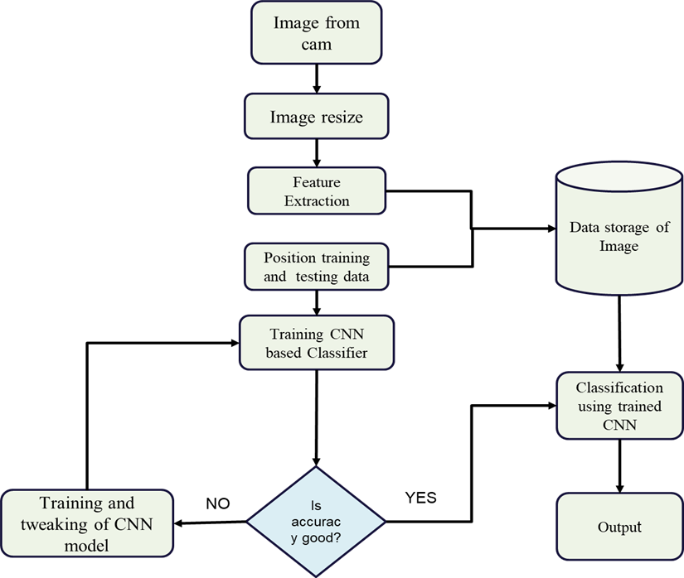
7
FLOW CHART OF DATA COLLECTION, TESTING, TRAINING, AND CLASSIFICATION

Slide 10
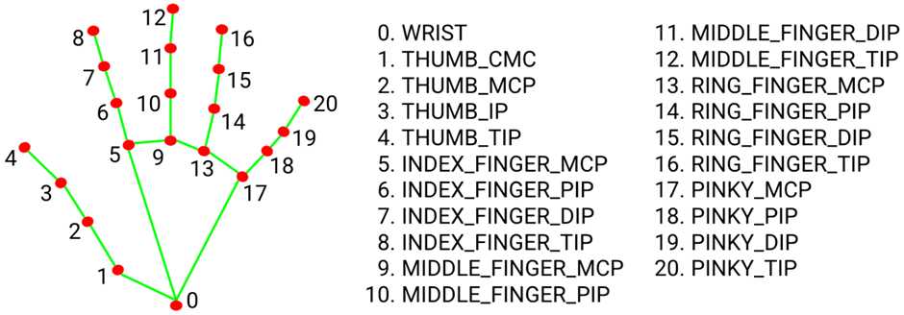
MEDIAPIPE’S LANDMARK SYSTEM
8

Slide 11
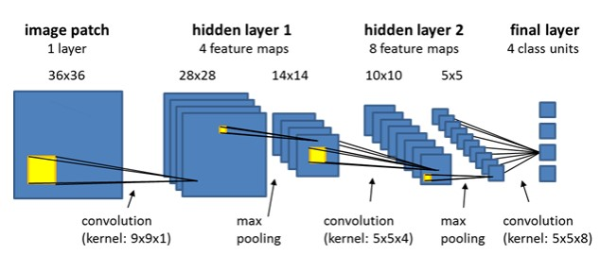
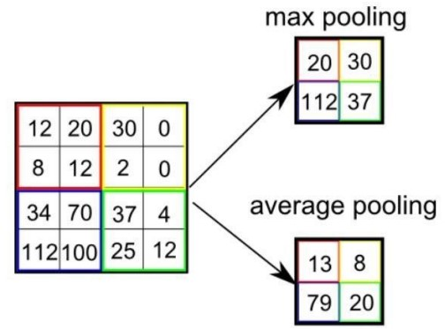
Different convolutional Layer average and Max pooling

Slide 12
SYSTEM IMPLEMENTATION
HARDWARE SPECIFICATION:
3 GB OF FREE DRIVE
8 GB OF RAM
QUAD CORE CPU/GPU
SOFTWARE SPECIFICATION:
OS – WINDOWS/MAC/LINUX
LANGUAGE - PYTHON
IDE - VSCODE
INTERPRETER VERSION: 3.7
9

Slide 13
TECHNOLOGIES USED
OPENCV
KERAS
RESNET
VGG16
MOBILENET
INCEPTIONRESNETV2
INCEPTIONV3
NUMPY
NEURAL NETWORKS
DEEP LEARNING
10

Slide 14
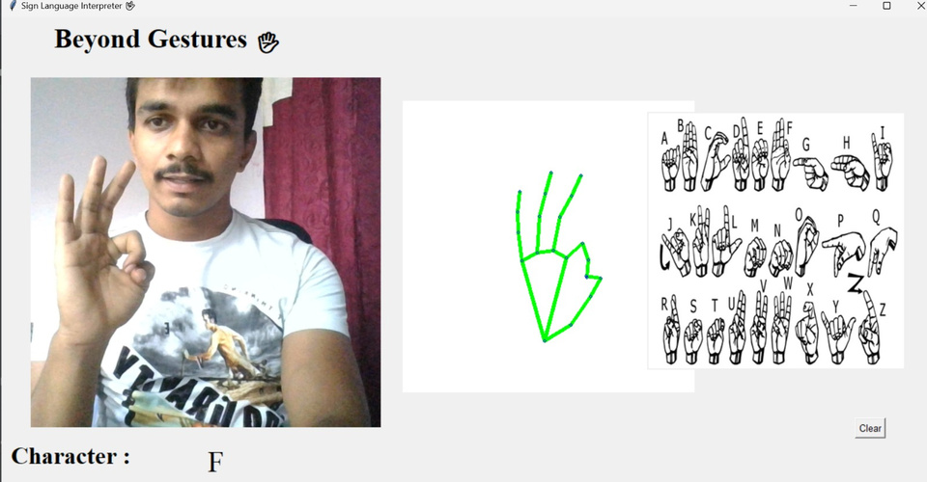
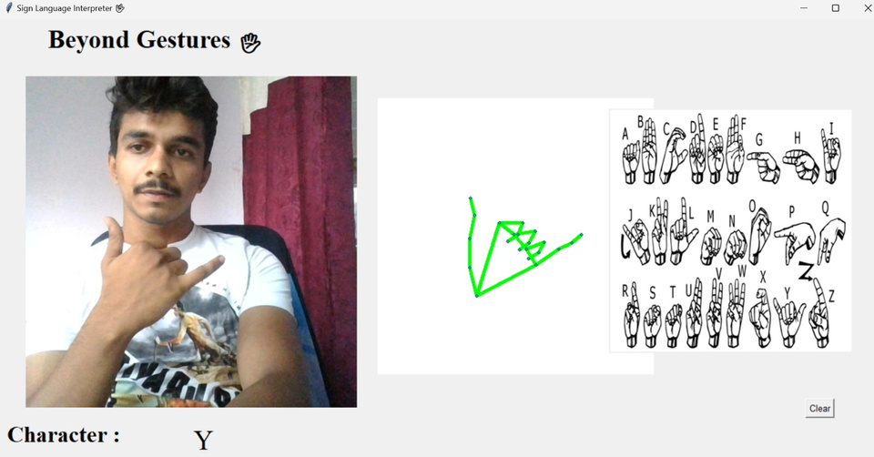
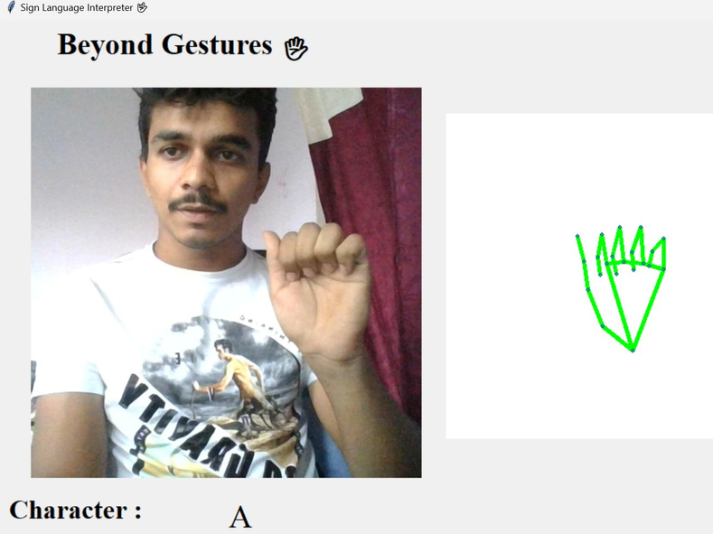
RESULTS
11

Slide 15
CONCLUSION
The project successfully demonstrates the potential of advanced image processing techniques and machine learning algorithms, achieving an impressive 95% accuracy in sign language recognition.
By integrating libraries like OpenCV, TensorFlow, and NumPy, along with real-time ASL translation methods such as edge detection and cross-correlation, the implementation showcases promising results.
The addition of a graphical user interface enhances user interaction and data collection, paving the way for continuous system improvement and adaptation.

Slide 16
REFERENCES
[1] Dhiman, M., 2021. Summer Research Fellowship Programme of India's Science Academies 2017. [online] AuthorCafe.
[2] T D, Sajanraj & M V, Beena. (2018). Indian Sign Language Numeral Recognition.
Using Region of Interest Convolutional Neural Network.
[3] Chen, J., 2021. CS231A Course Project Final Report Sign Language Recognition.
[4] P.Amatya,k.Sergieva & G. Meixener," Translation of Sign Language Into Text Using Kinect for Windows v2".
[5] A. Joshi, H. Sierra & E. Arzuaga," American sign language translation using edge detection and cross-correlation".

Slide 17
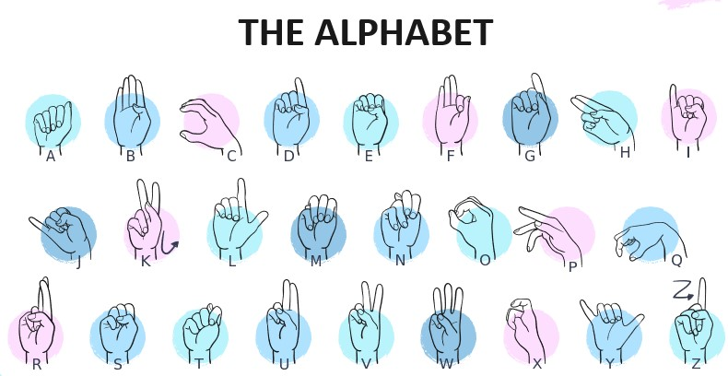

Slide 18
THANK YOU

